Slide 1
F2F Meeting

Slide 2
Contents
KEGG Enrichment plots: slides 4-12
Pathway Heatmaps / KEGG Pathview diagrams: slides 13-end
Ferroptosis
JAK/STAT
MAPK
Cell cycle
Tight Junction
Glycolysis / Gluconeogenesis
PI3K-Akt
NOD-Like receptor
Insulin Signalling Pathway
Toll-Like Receptors
Non-alcoholic Fatty Liver disease
Oxidative Phosphorylation

Slide 3
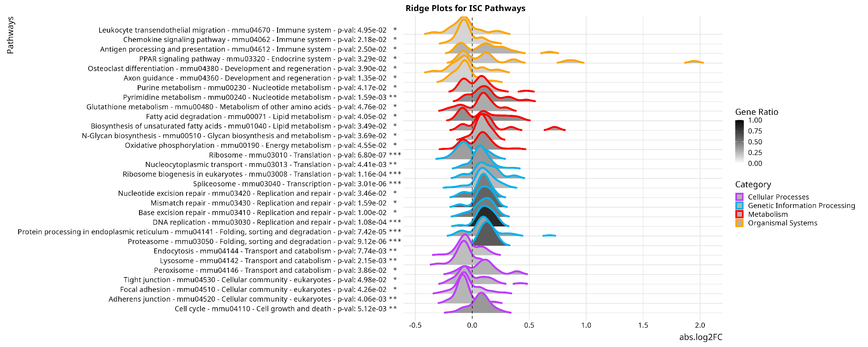
KEGG Enriched Pathways - ISC

Slide 4
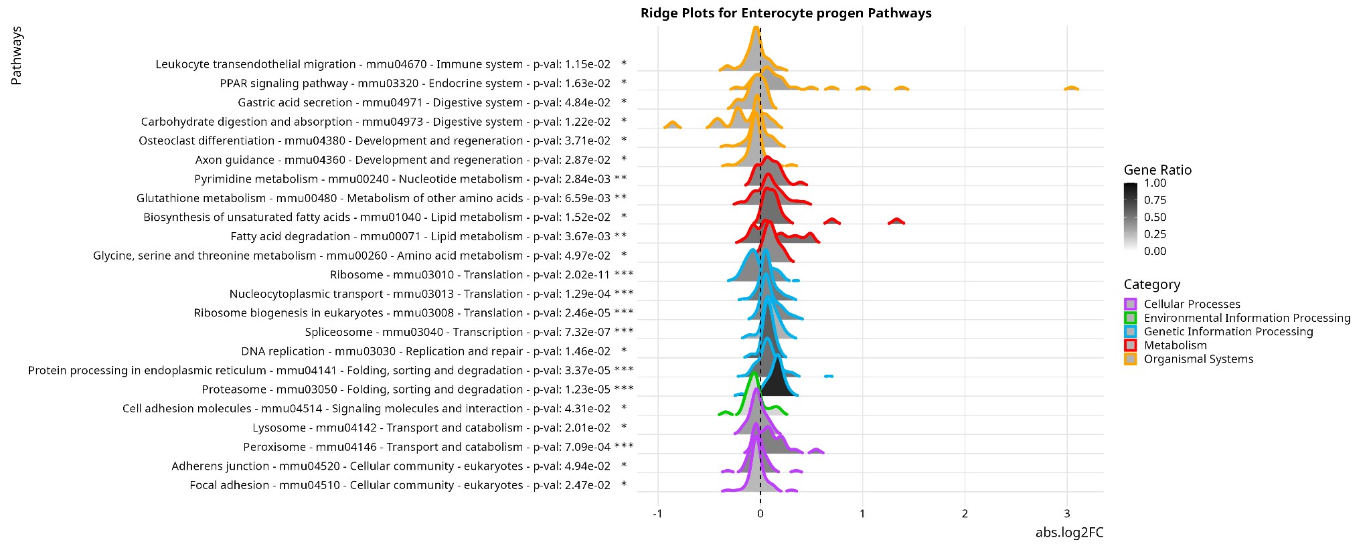
KEGG Enriched Pathways - Enterocyte Progenitor

Slide 5
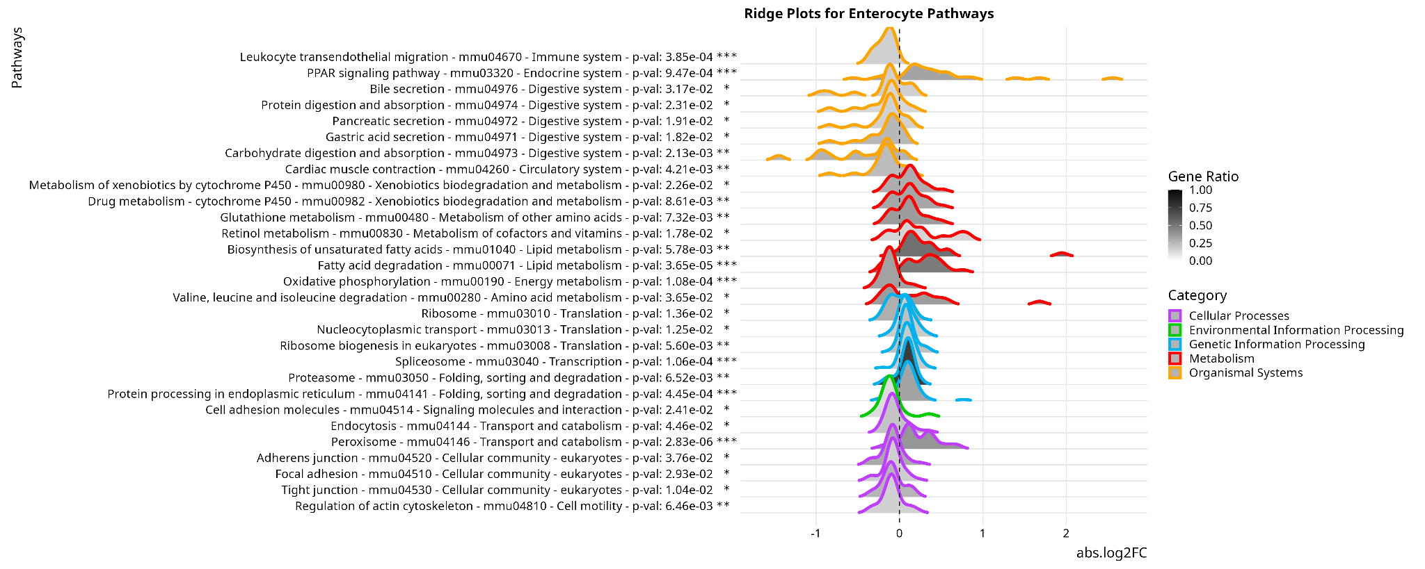
KEGG Enriched Pathways - Enterocyte

Slide 6
KEGG Enriched Pathways - Paneth / Paneth Progenitor
Removed from Analysis
“Note that we excluded the Paneth cell lineage from the scRNA-seq analysis because of reported sampling issues, which might impact cell-type ratios 17. …
… As we excluded Paneth cells from our scRNA-seq analysis, we determined the Paneth cell numbers in situ and found no difference between CD- and HFHSD-fed mice (Extended Data Fig. 4f,g). “

Slide 7
KEGG Enriched Pathways - Enteroendocrine Progenitor
No Enriched Pathways

Slide 8
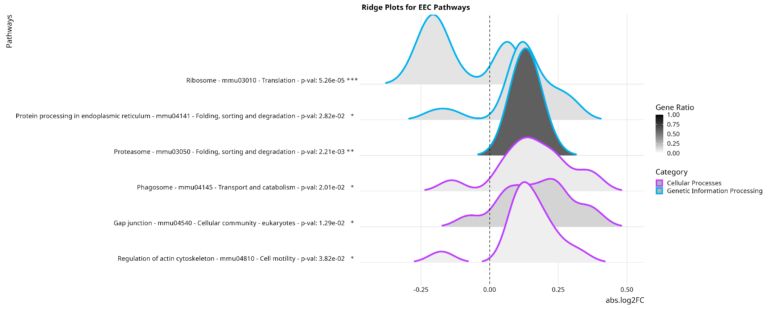
KEGG Enriched Pathways - Enteroendocrine

Slide 9
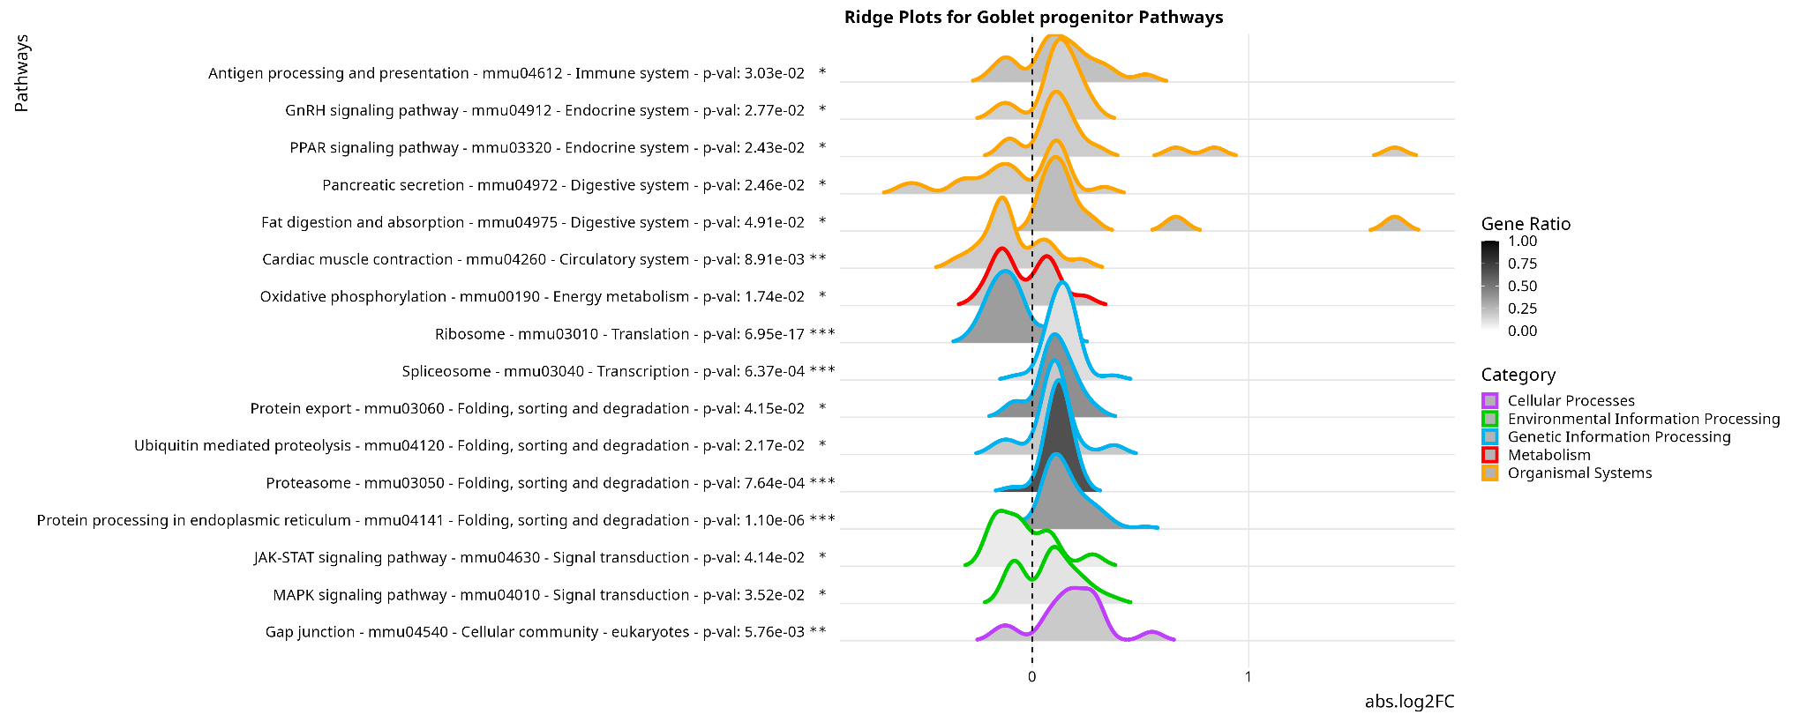
KEGG Enriched Pathways - Goblet Progenitor

Slide 10
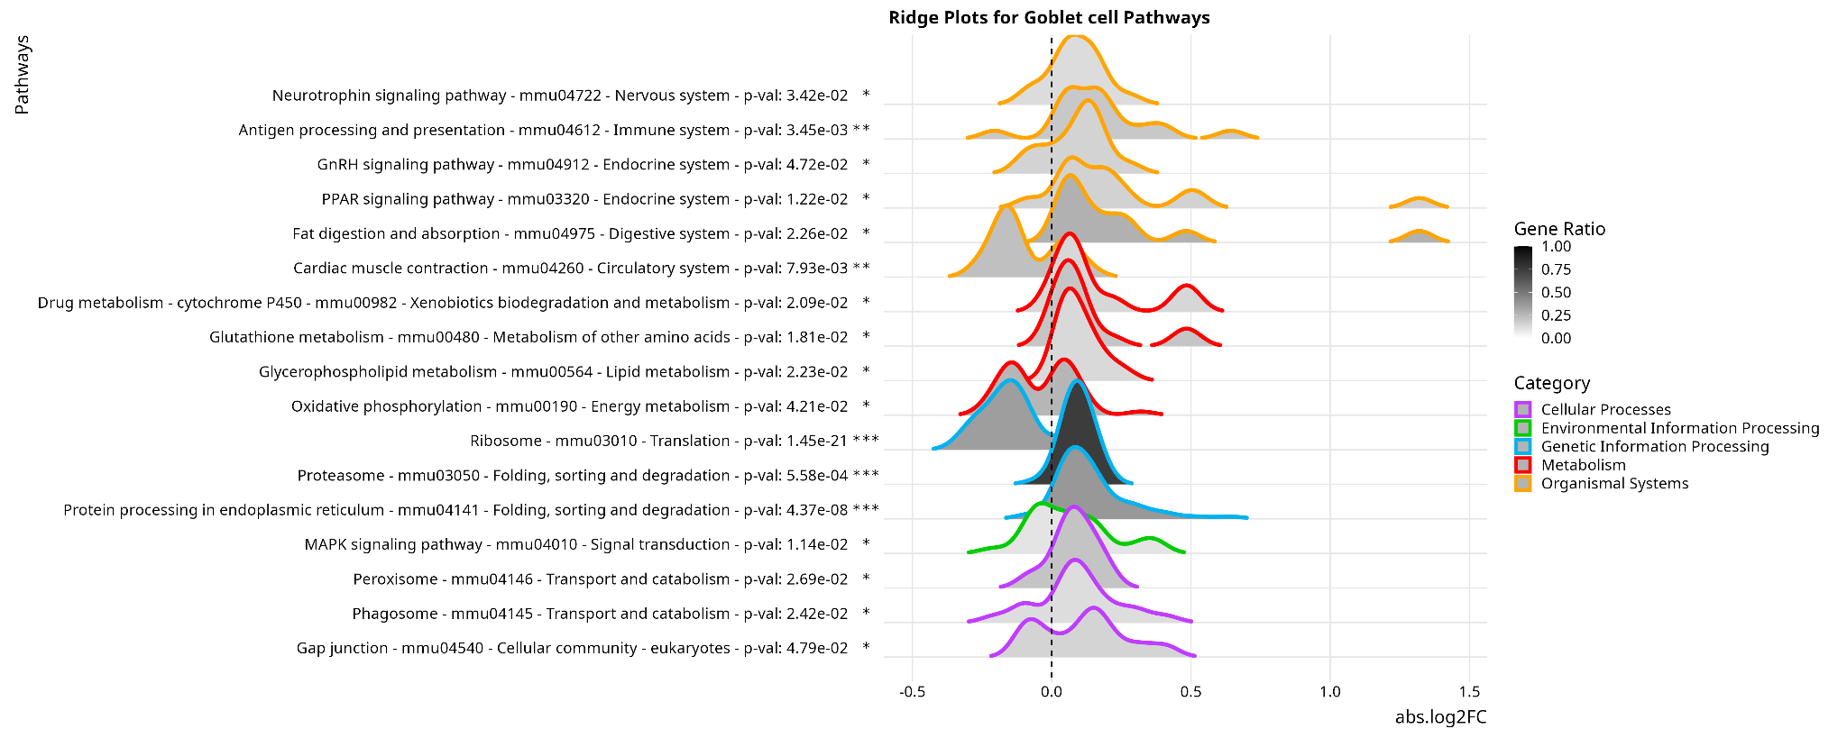
KEGG Enriched Pathways - Goblet

Slide 11
KEGG Enriched Pathways - Tuft Progenitor
No Enriched Pathways

Slide 12
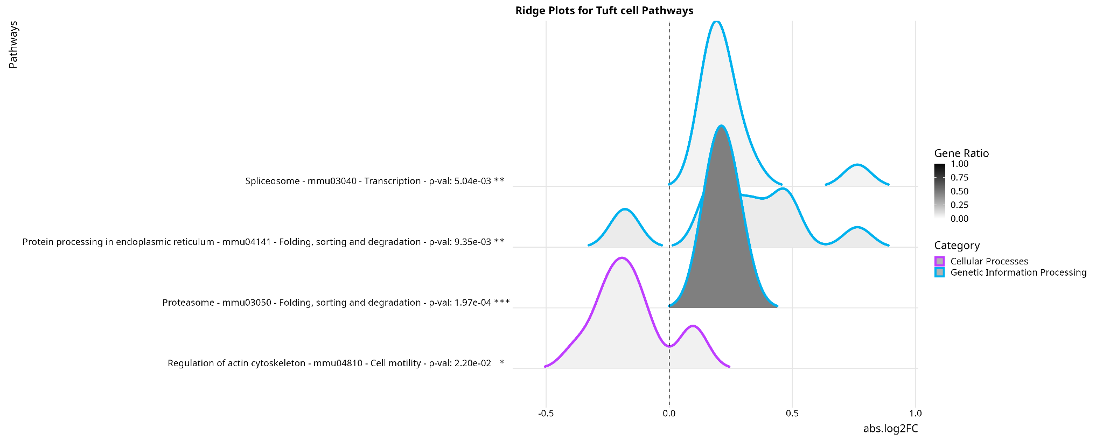
KEGG Enriched Pathways - Tuft

Slide 13
Individual KEGG Pathway Analysis
Some pathways we are interested in will not appear in the enriched pathway analysis as not enough of the genes in their gene sets are significantly differentially expressed.
To analyse these, we can view their respective genes’ logFC values with a heatmap across all cell types.

Slide 14
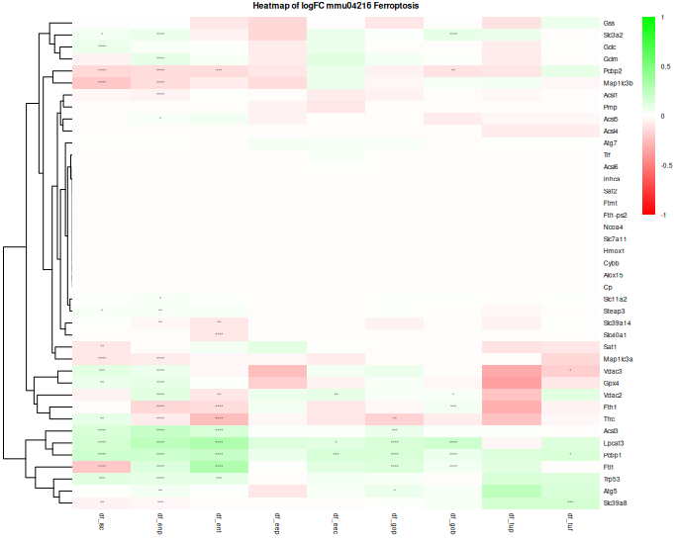
Ferroptosis
ISC ENP ENT EEP EEC GOP GOB TUP TUF

Slide 15
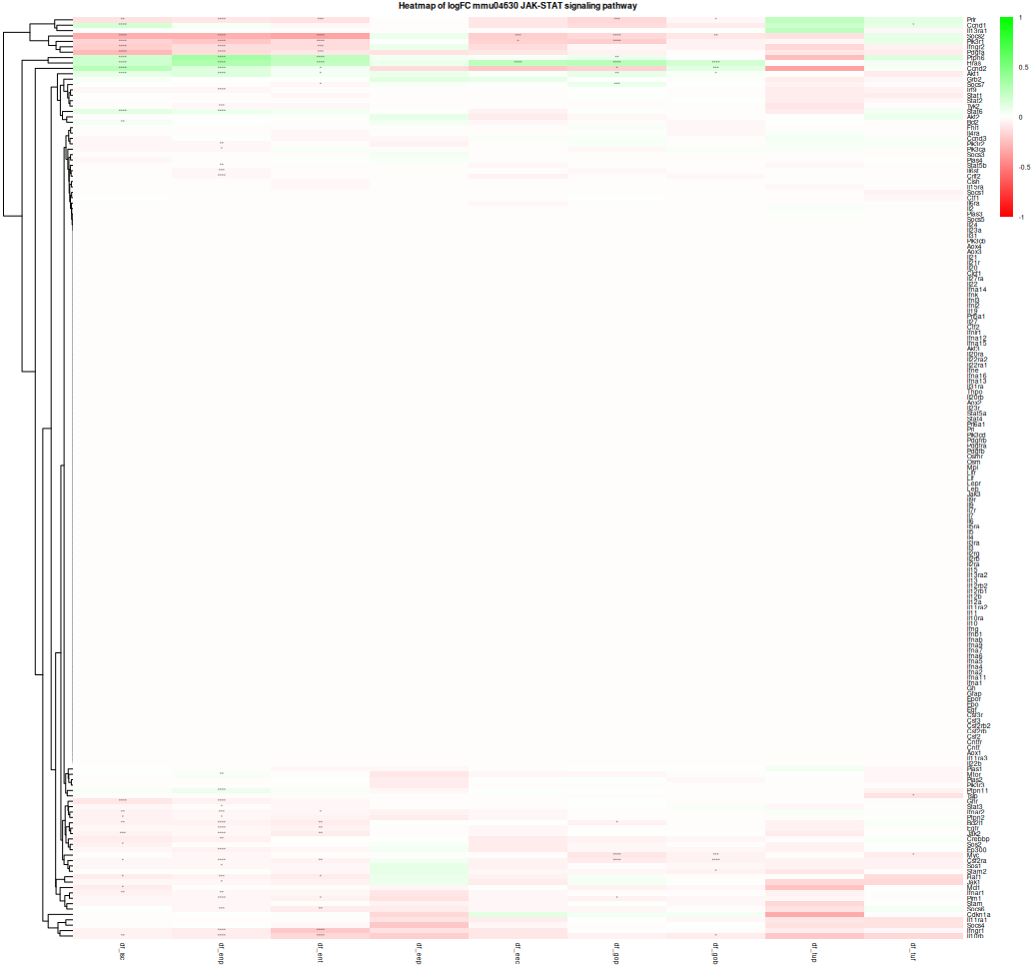
JAK/STAT
ISC ENP ENT EEP EEC GOP GOB TUP TUF

Slide 16
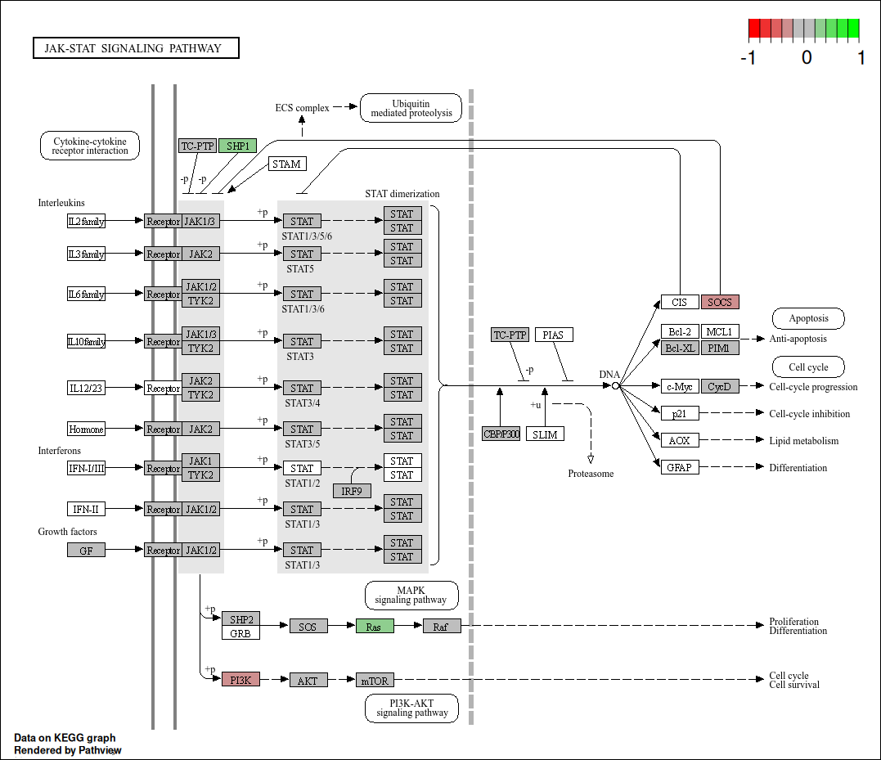
JAK/STAT
Ent. Prog.

Slide 17
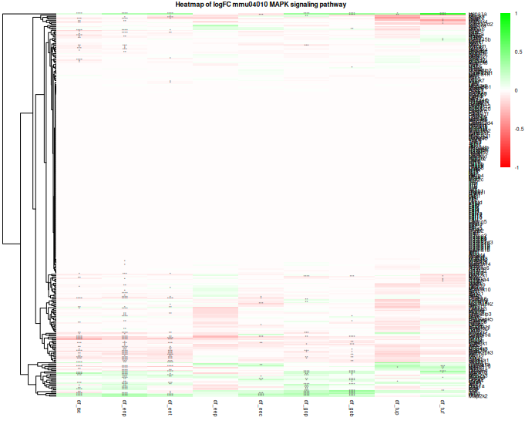
MAPK
ISC ENP ENT EEP EEC GOP GOB TUP TUF

Slide 18
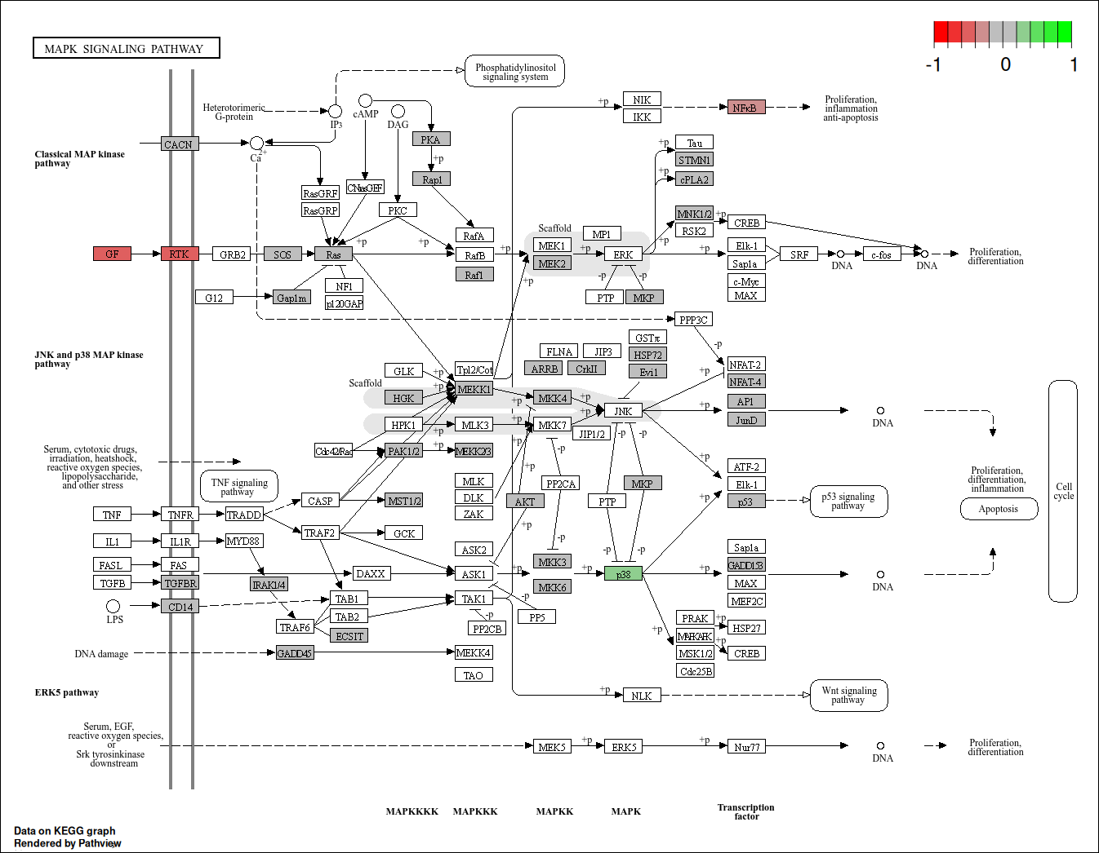
MAPK
ISC

Slide 19
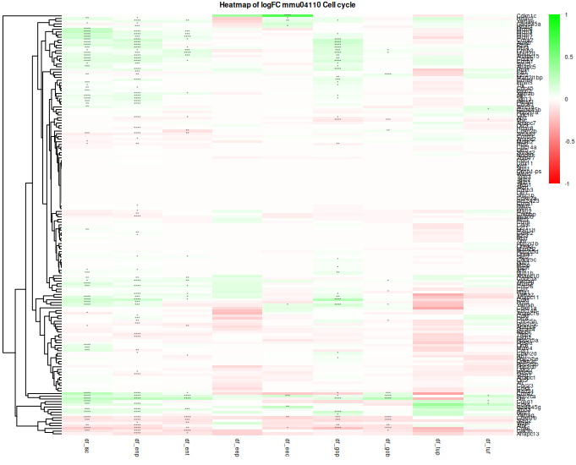
Cell
Cycle

Slide 20
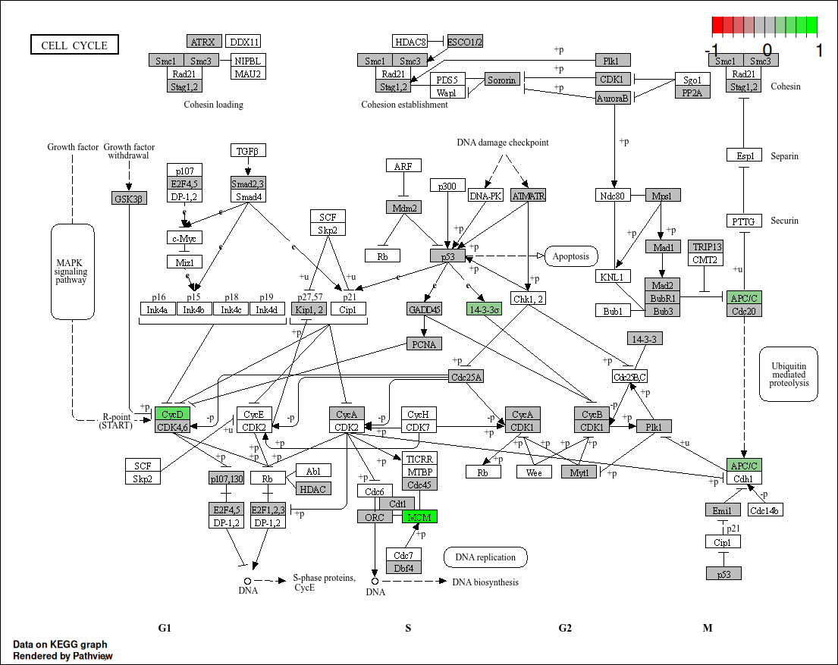
ISC

Slide 21
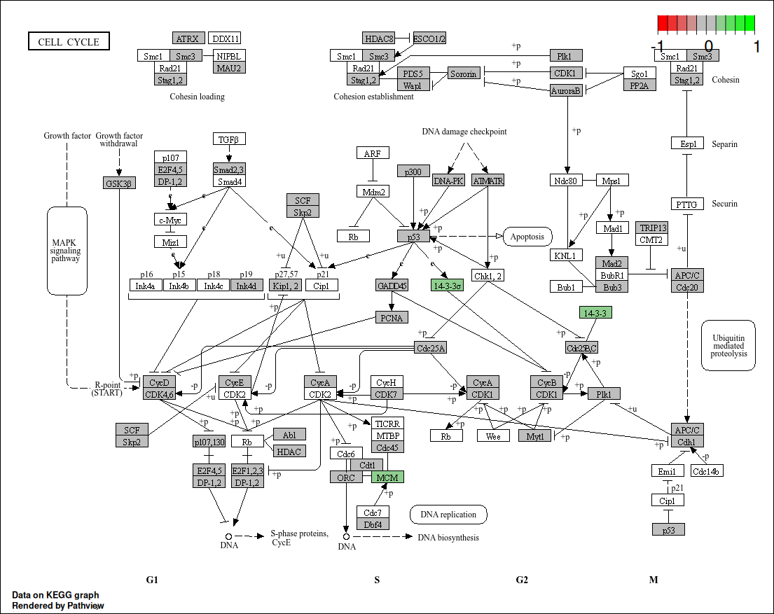
Ent
Prog

Slide 22
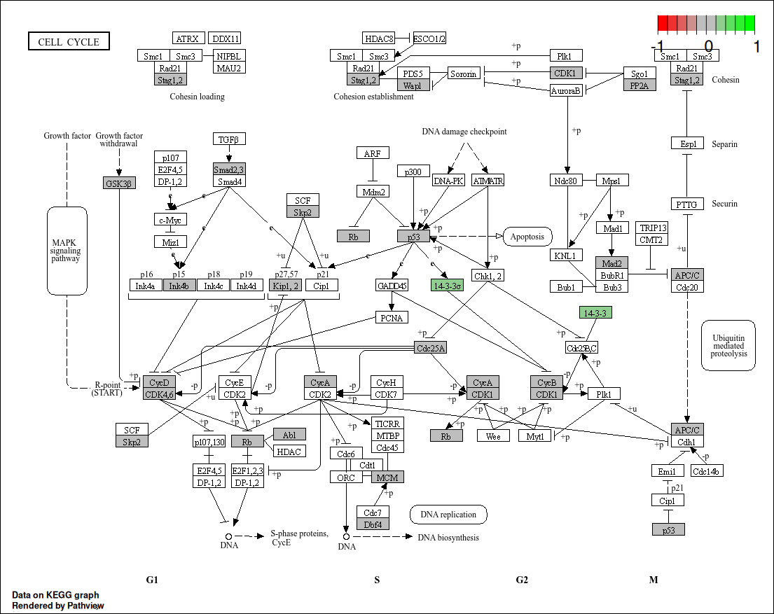
Ent

Slide 23
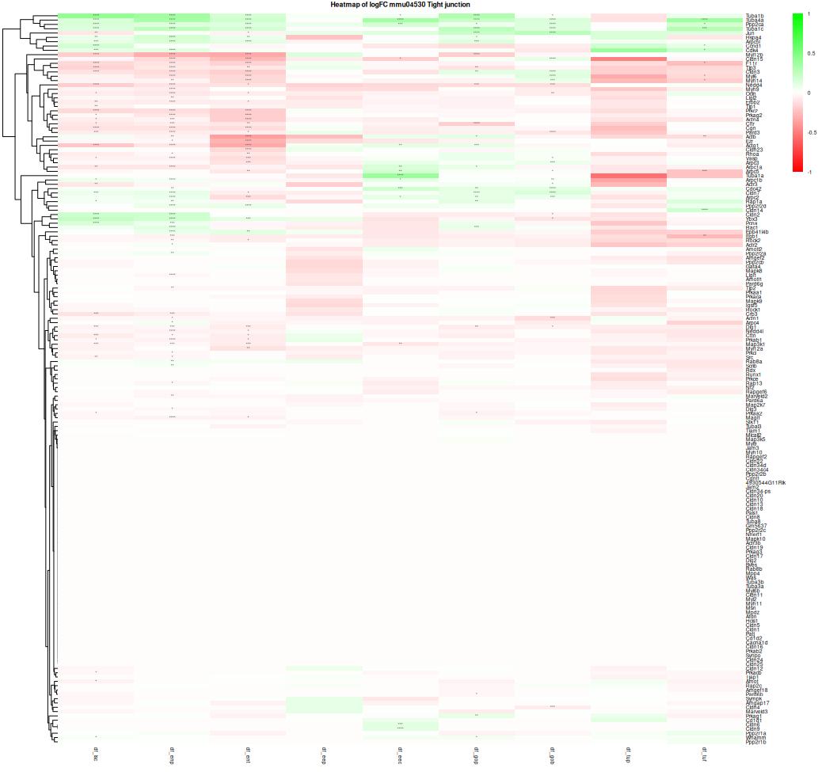
Tight Junction
ISC ENP ENT EEP EEC GOP GOB TUP TUF

Slide 24
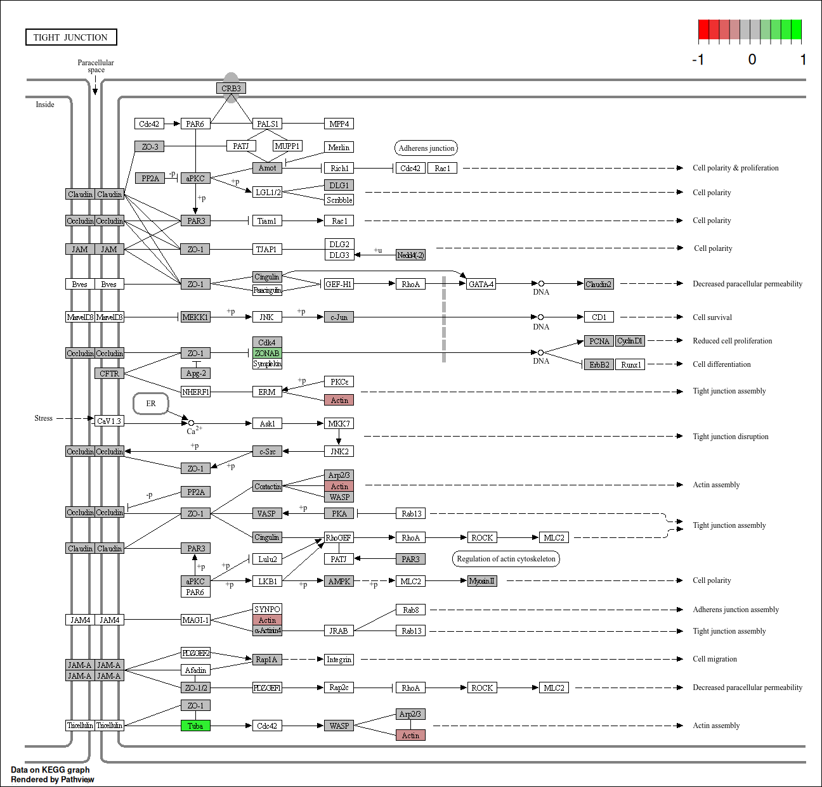
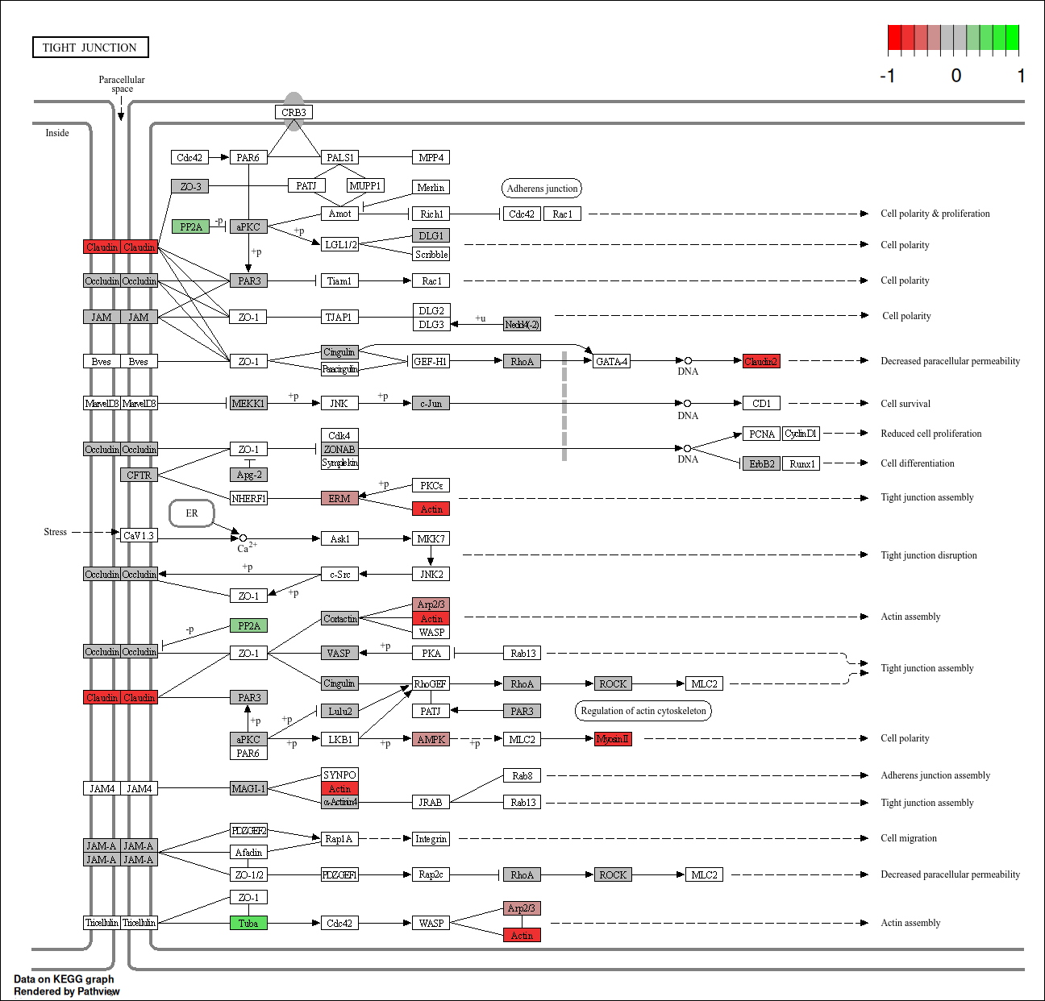
Tight Junction ISC
Tight Junction Enterocyte

Slide 25
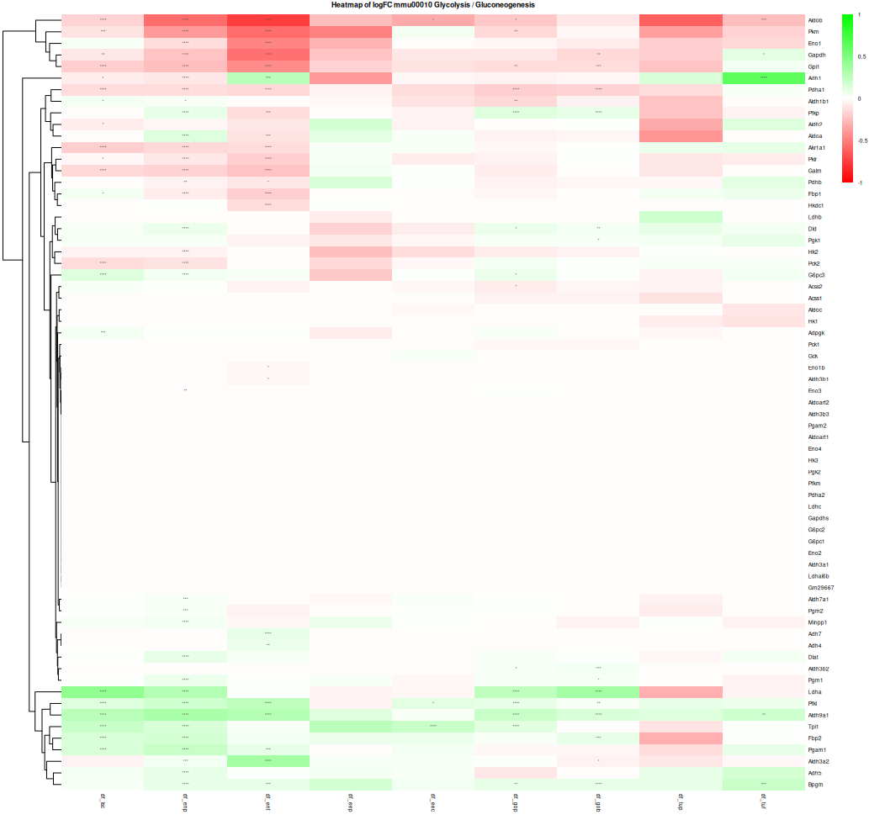
Glycolysis
/Gluconeogenesis

Slide 26
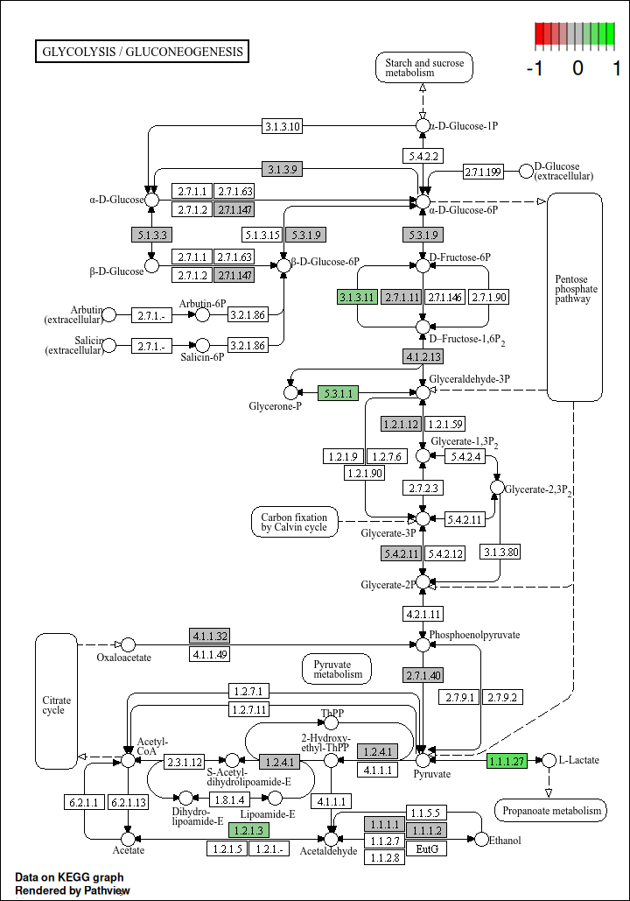
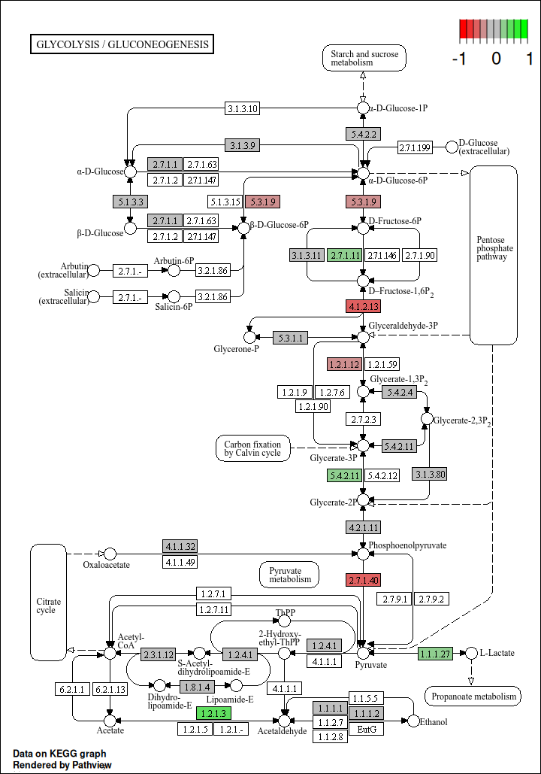
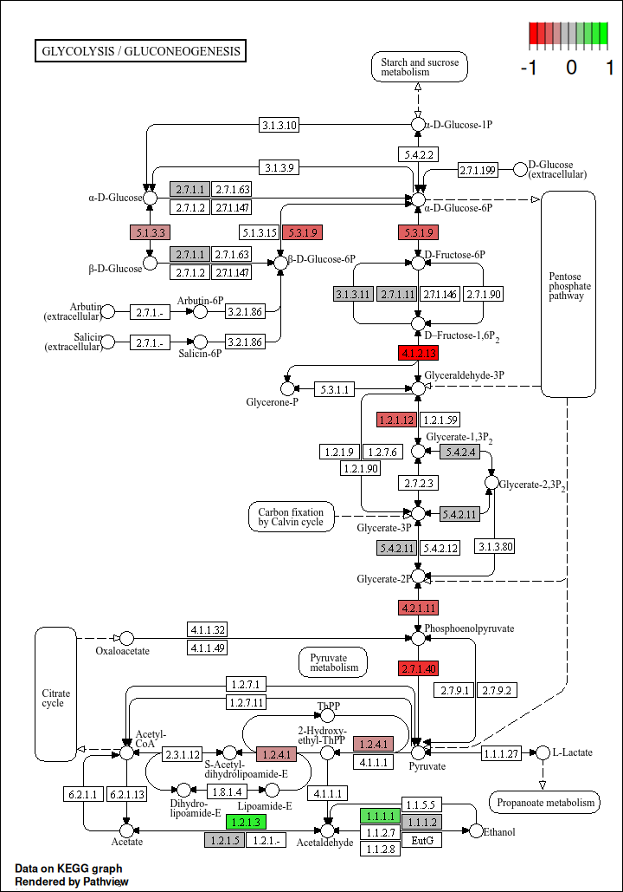
Glycolysis / Gluconeogenesis
ISC
Ent. Progen
Enterocyte

Slide 27
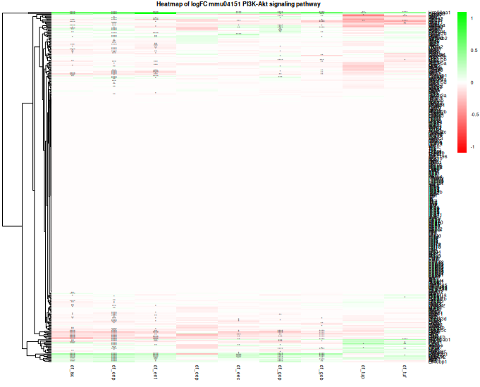
PI3K-Akt

Slide 28
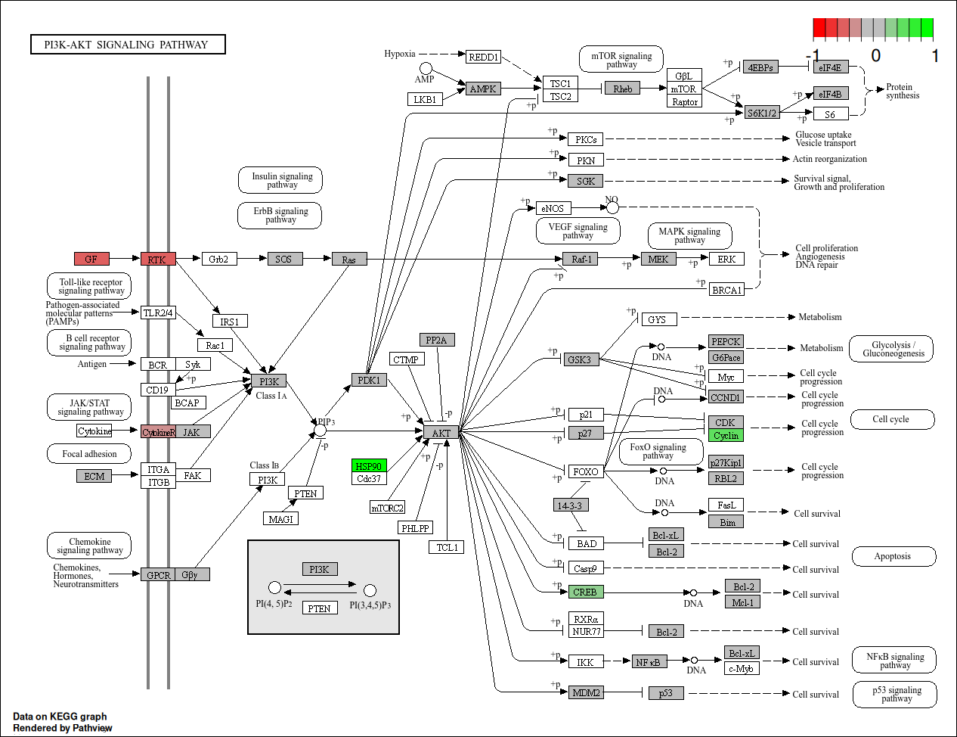
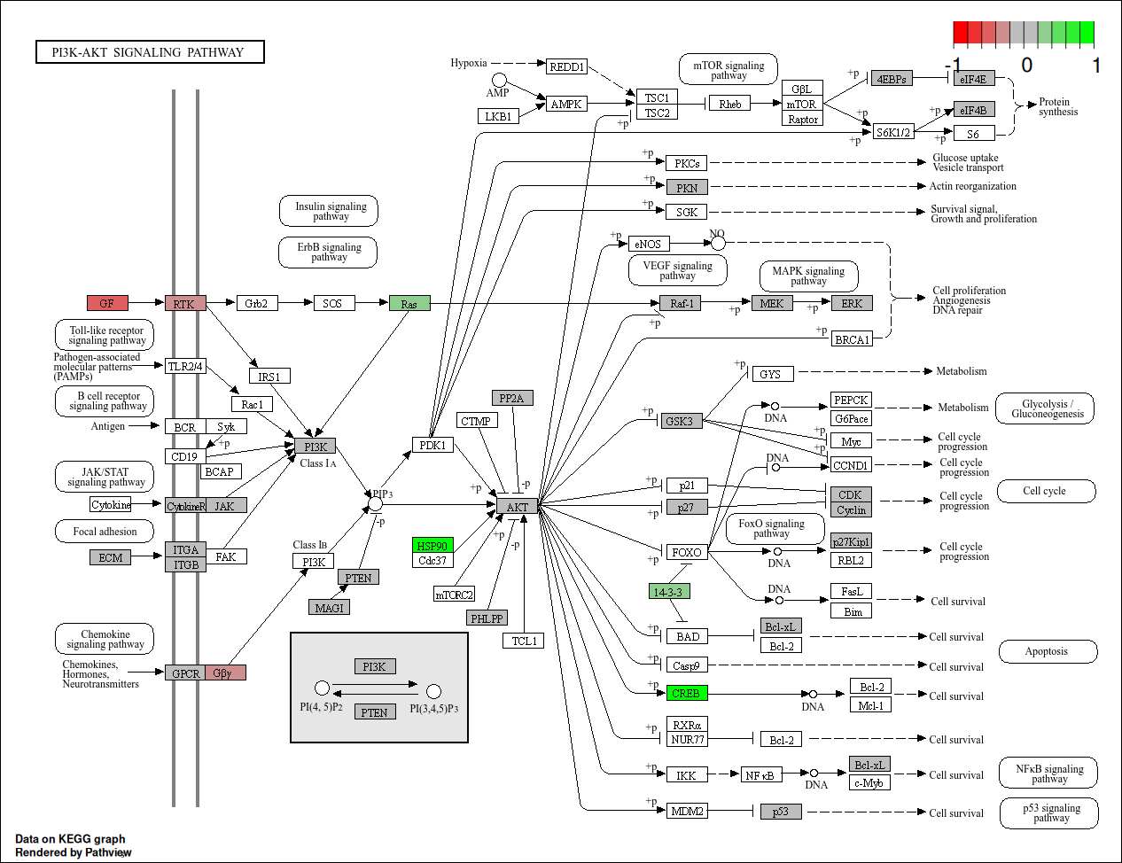
PI3K-Akt
ISC
Enterocyte

Slide 29
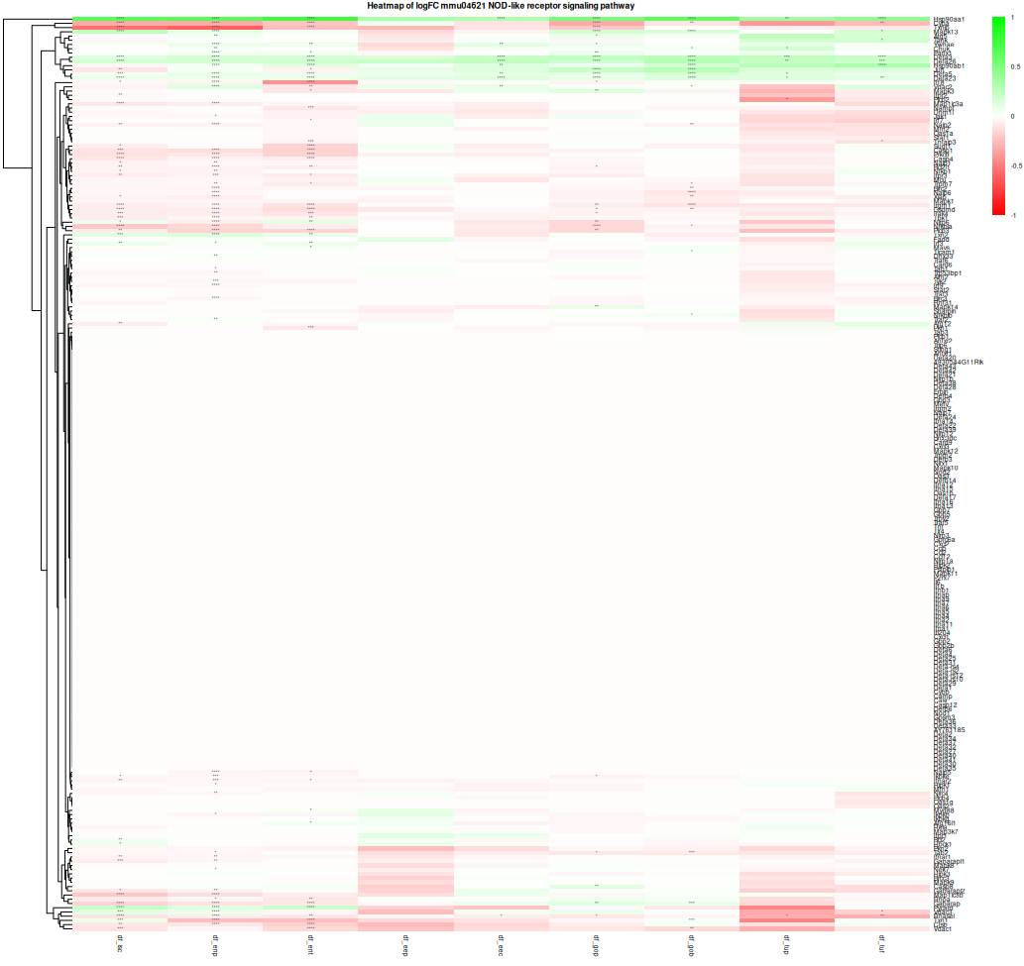
NOD-like receptor

Slide 30
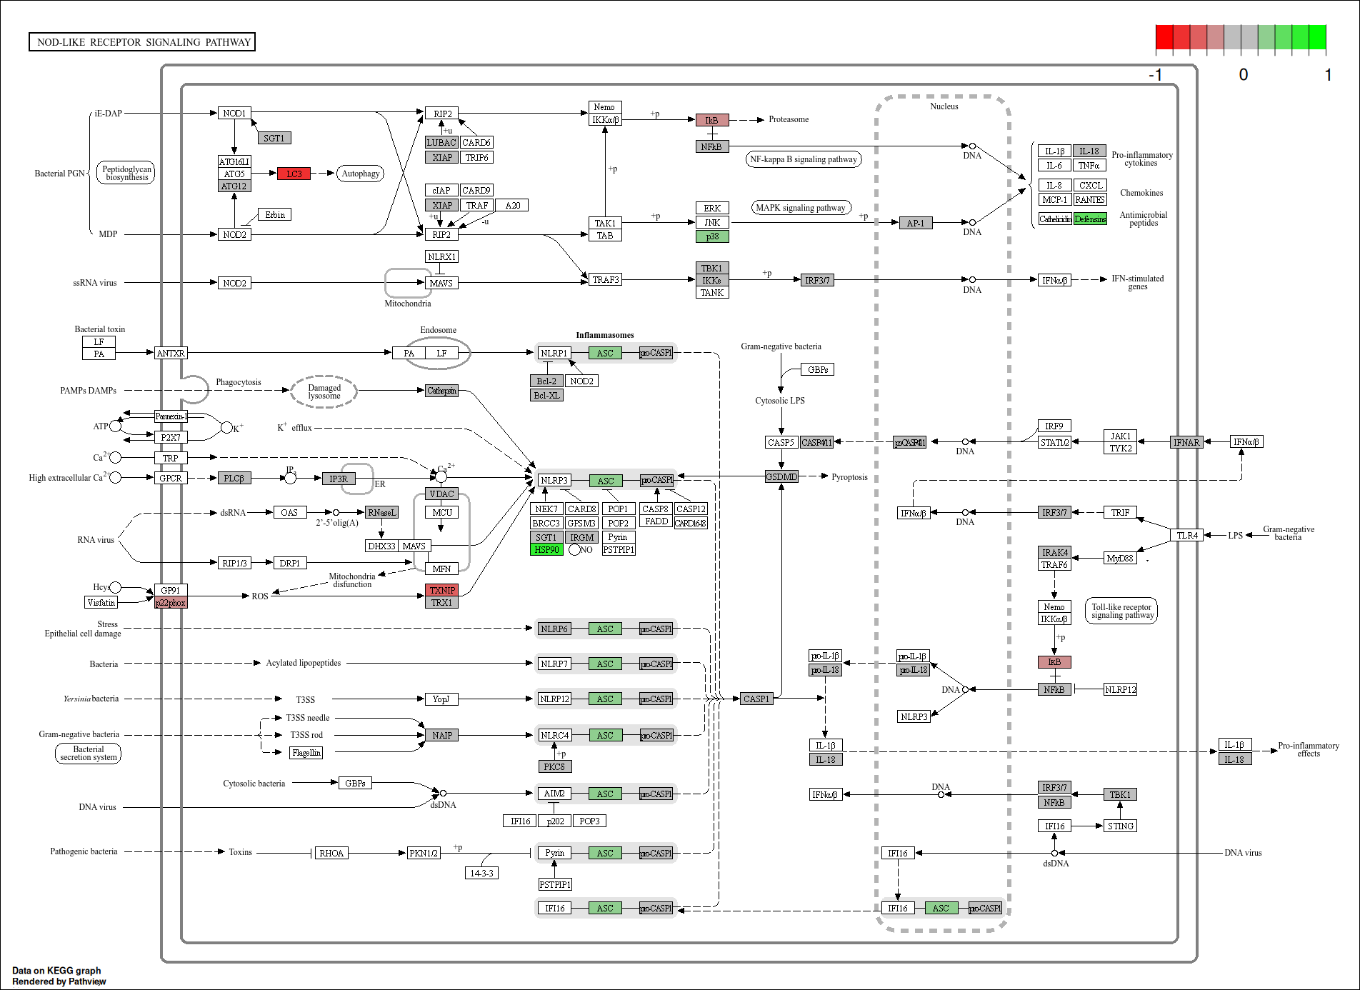
NOD-like receptor ISC

Slide 31
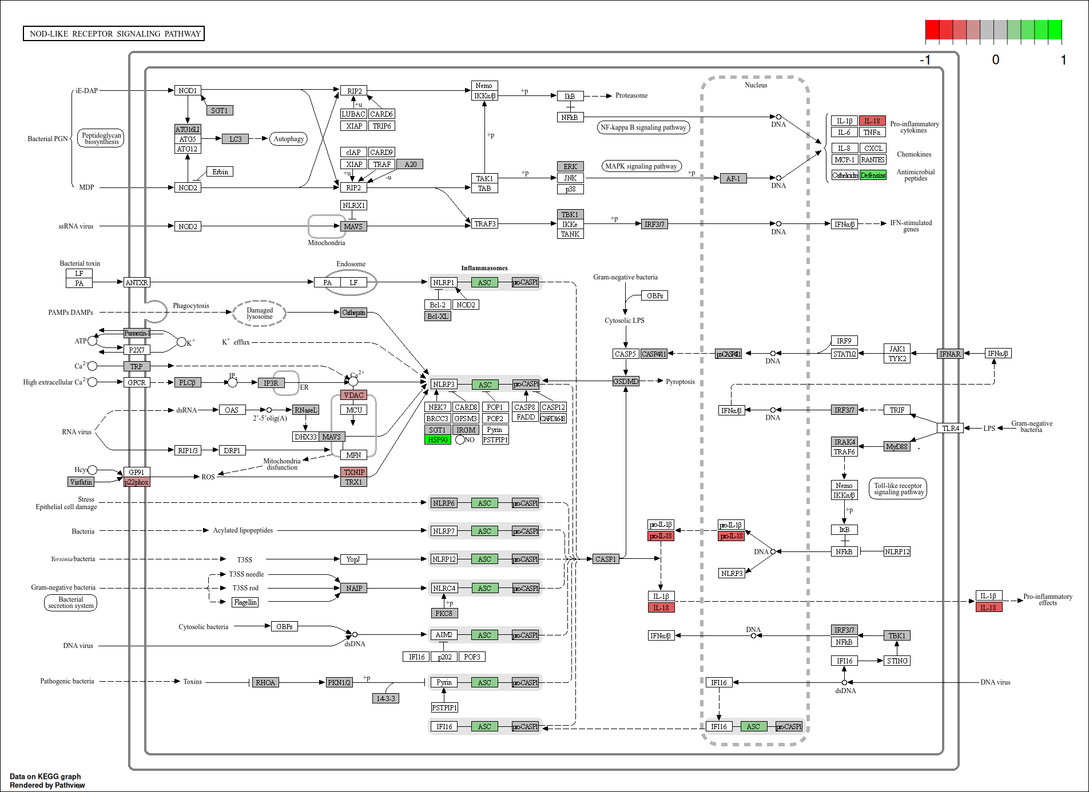
NOD-like receptor Enterocyte

Slide 32
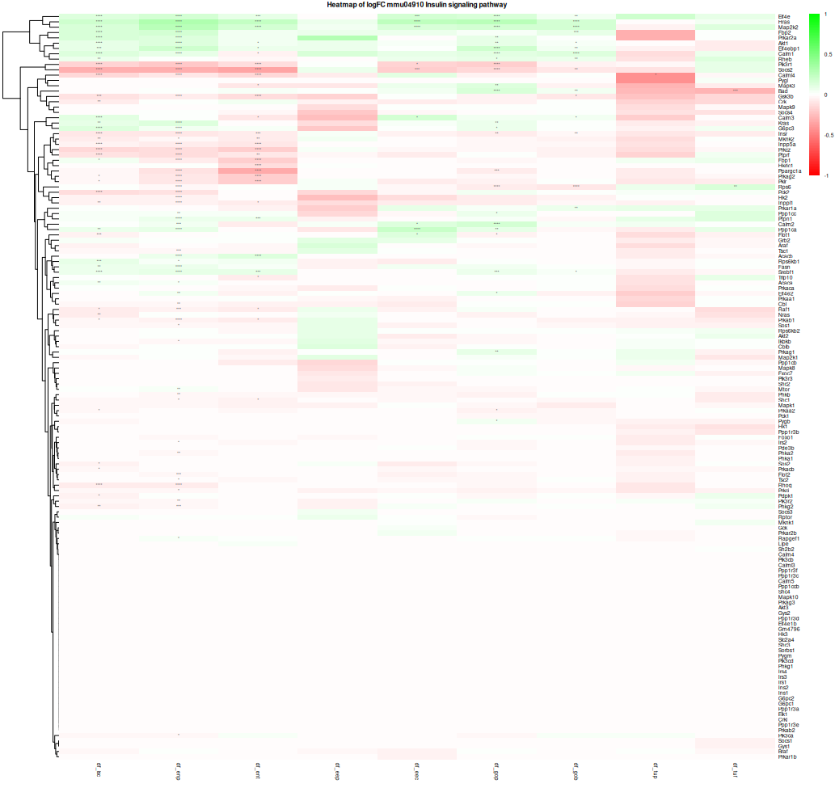
Insulin Signalling
Pathway

Slide 33
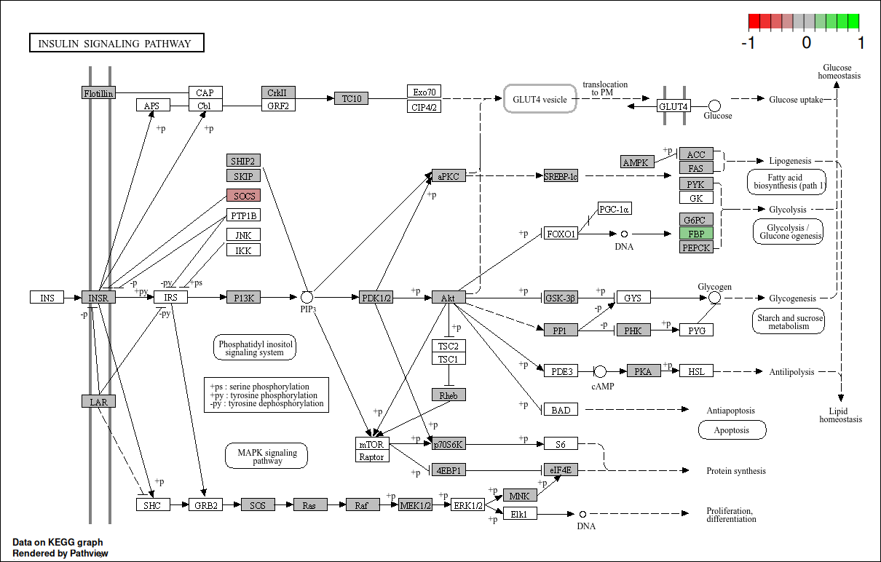

Slide 34
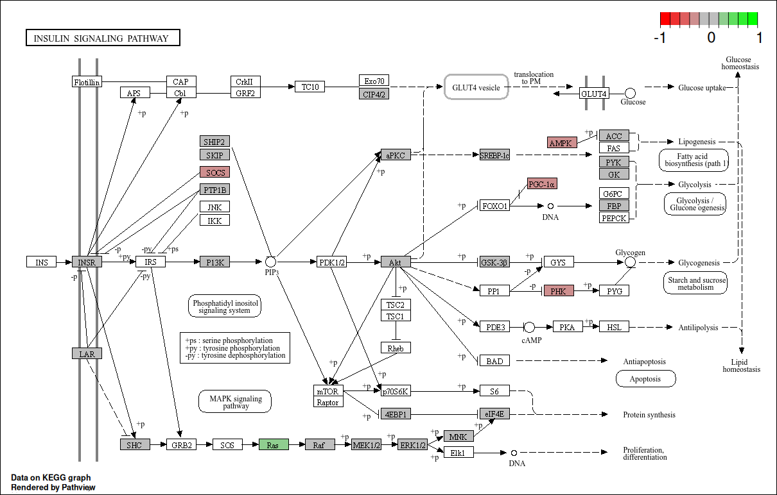

Slide 35
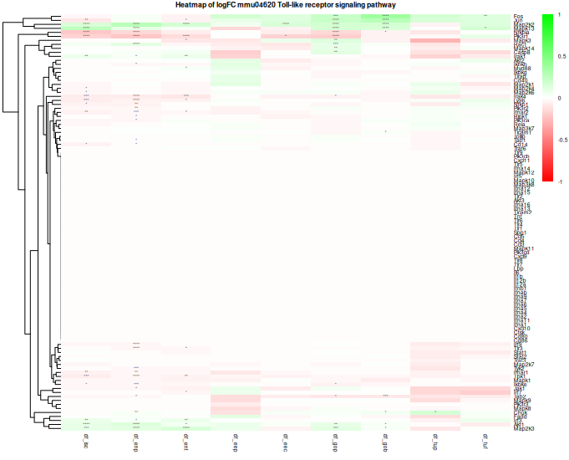
Toll-like
Receptor

Slide 36
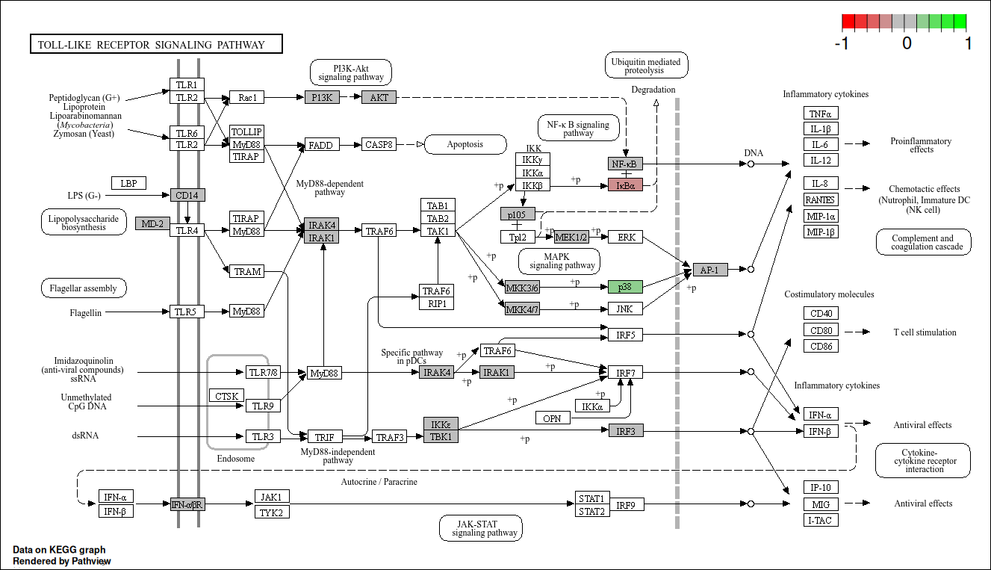
Toll-like receptor Enterocyte

Slide 37
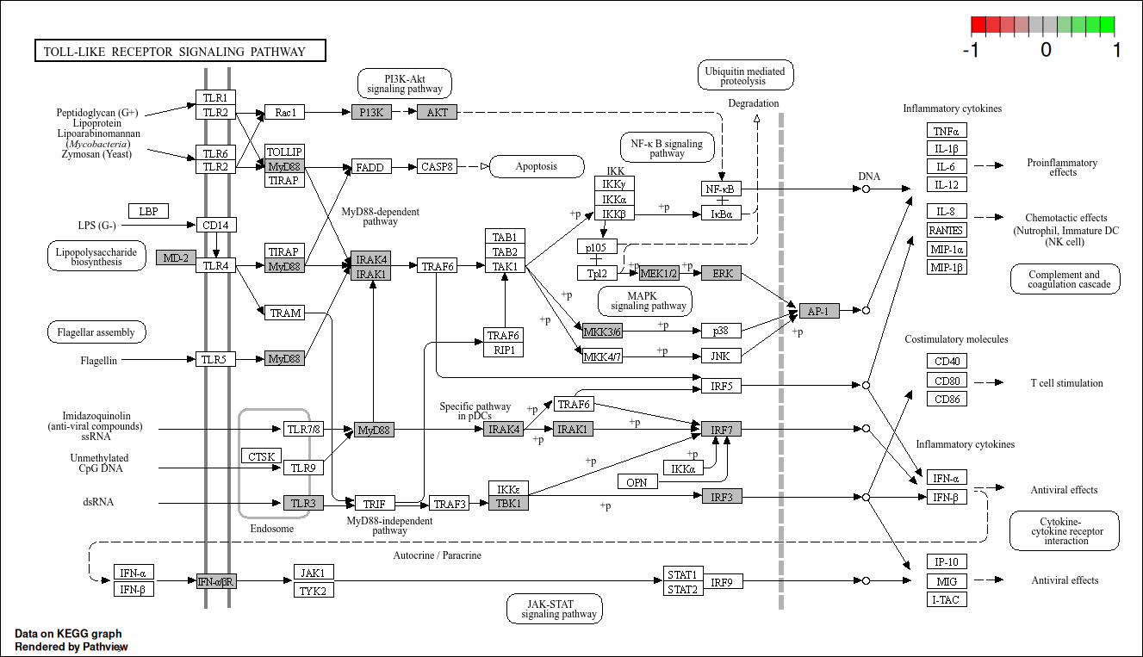
Toll-like receptor ISC

Slide 38
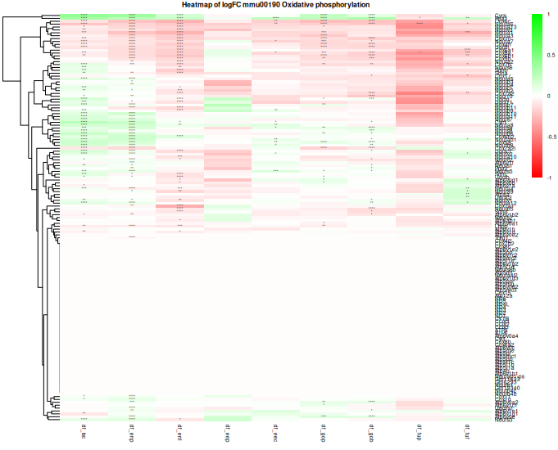
Oxidative Phosphorylation

Slide 39
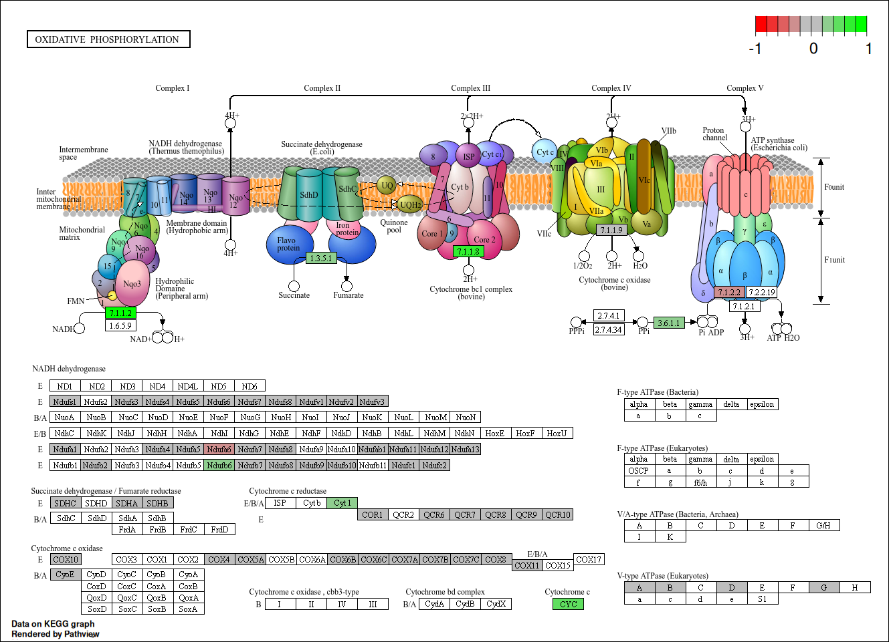

Slide 40
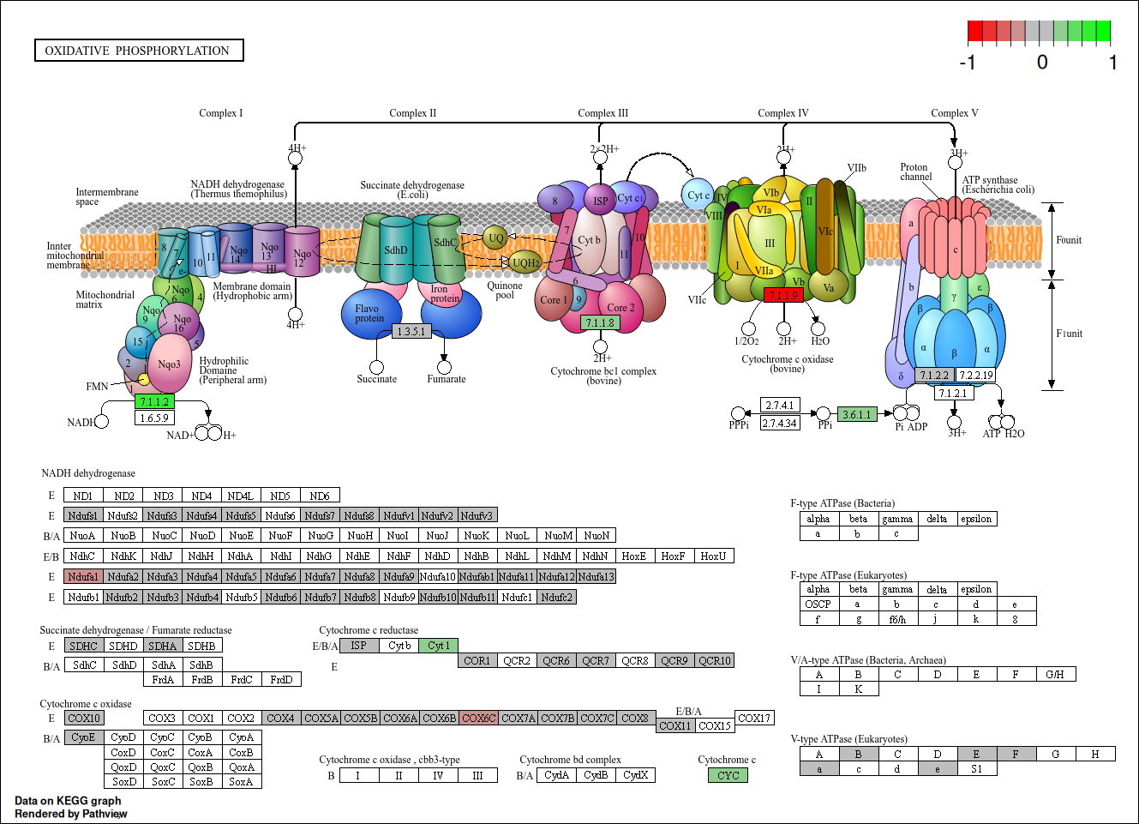

Slide 41
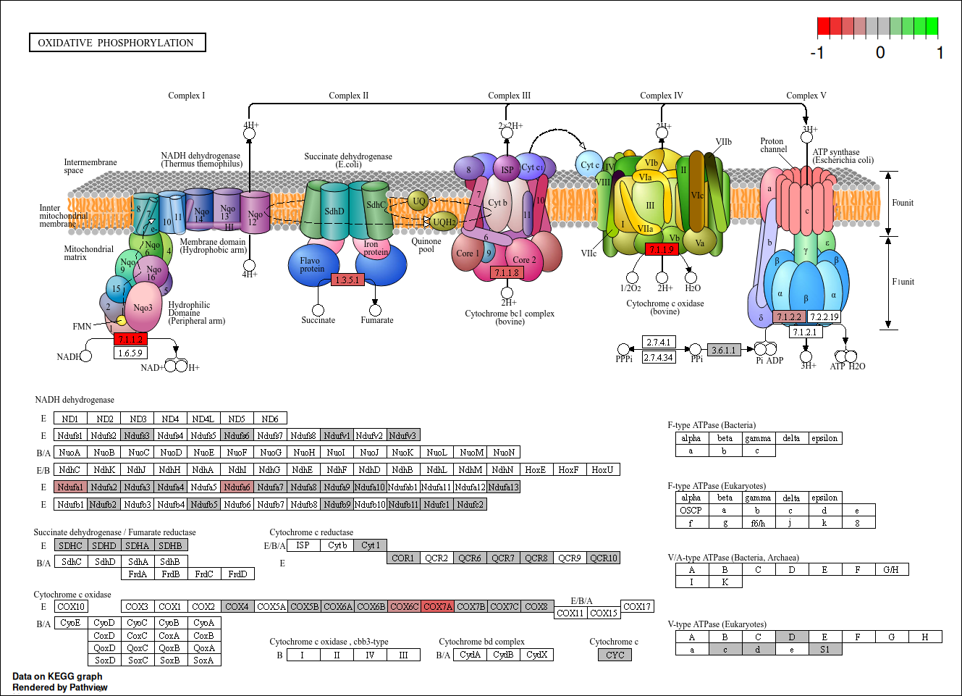

Slide 42
Further analysis of enriched pathways
Proteasome
Spliceosome
Protein Processing in endoplasmic reticulum
Fatty acid degradation
DNA replication

Slide 43
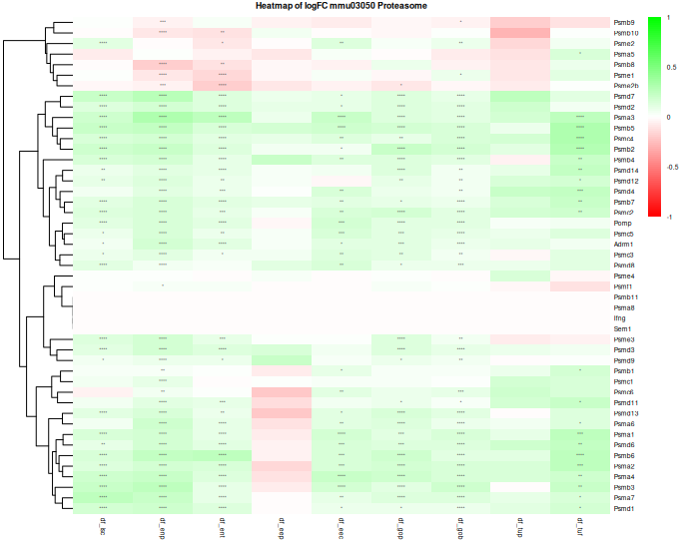

Slide 44
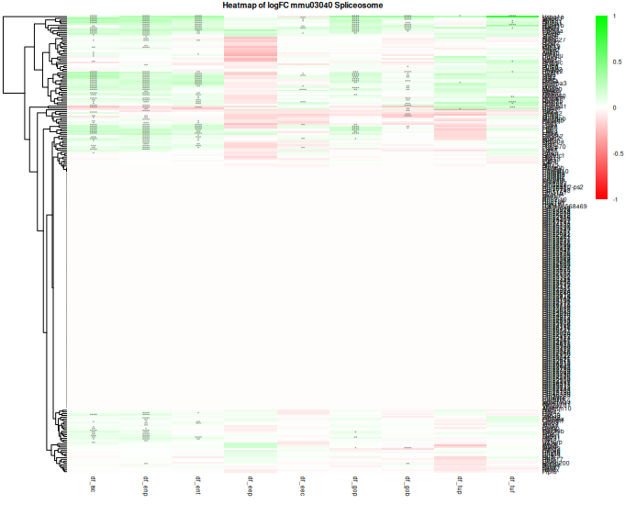

Slide 45
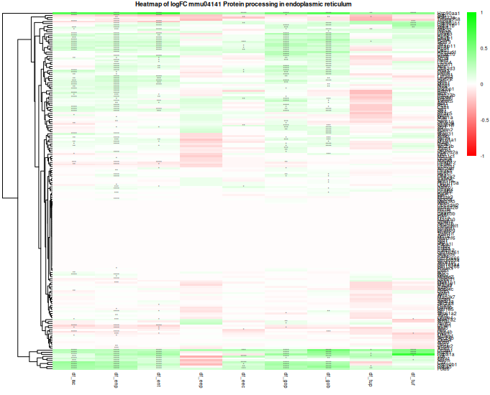

Slide 46
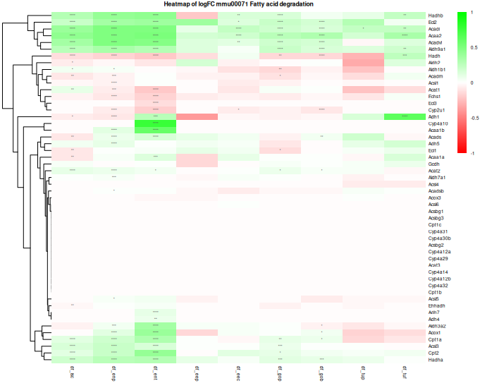

Slide 47
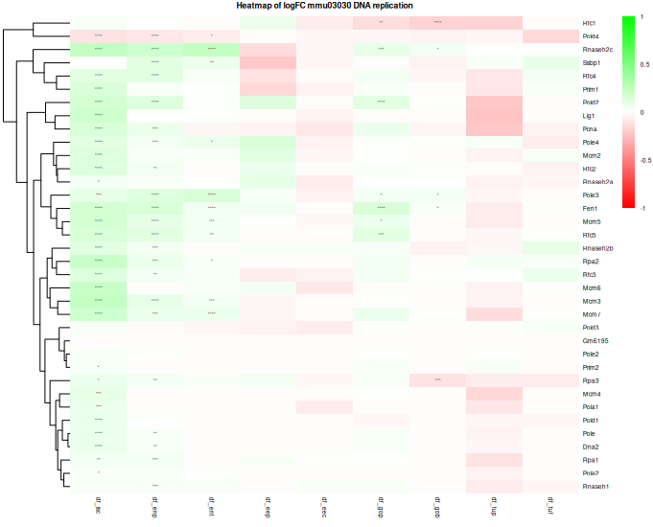

Slide 48
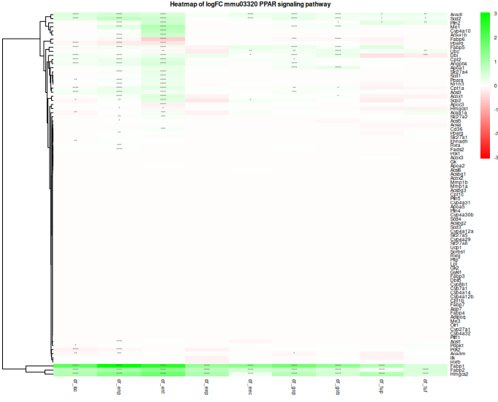

Slide 49
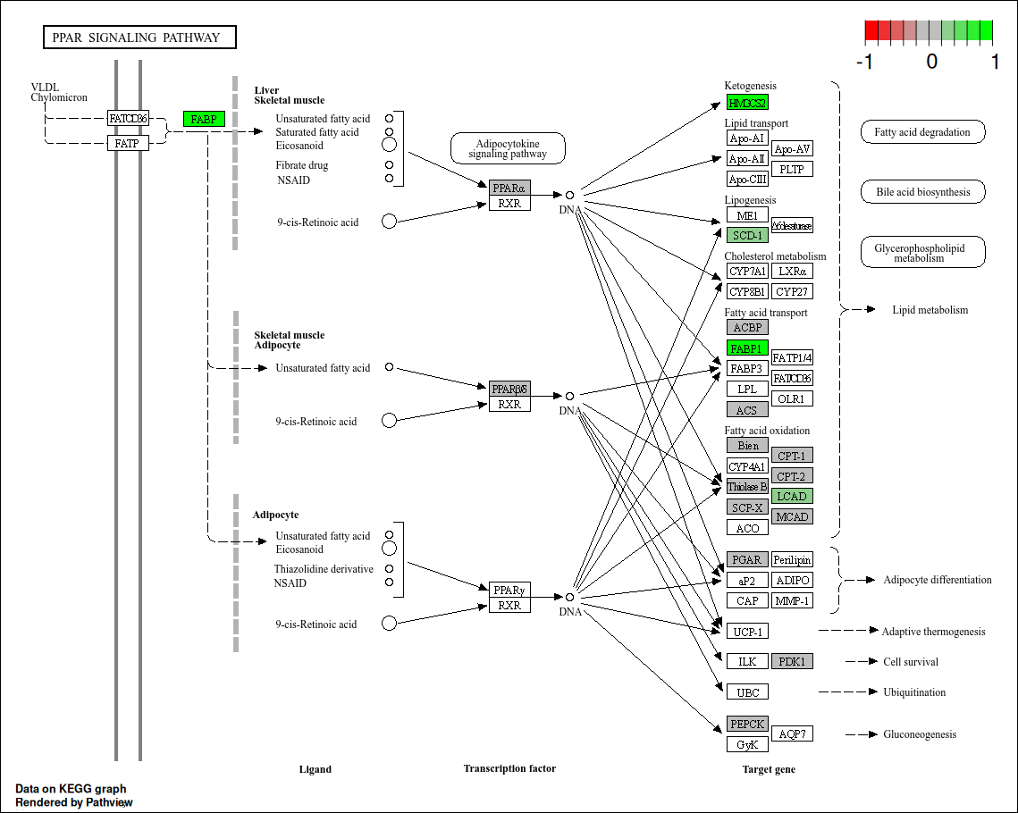

Slide 50
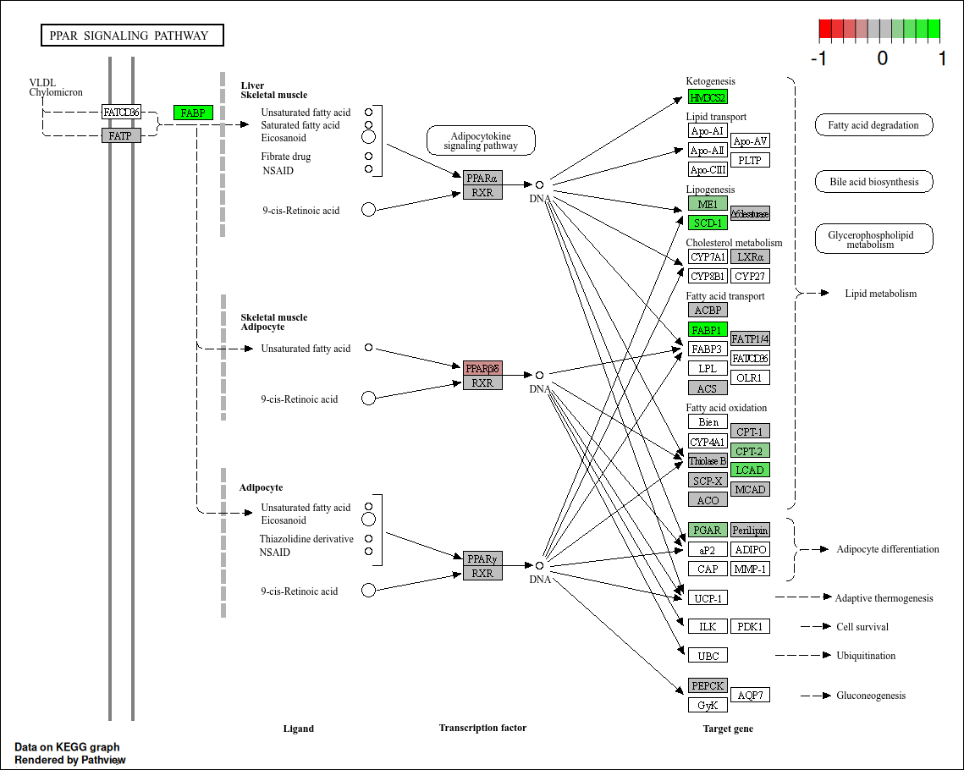

Slide 51
